Slide 1

YAY! - Celebrating Education

Slide 2
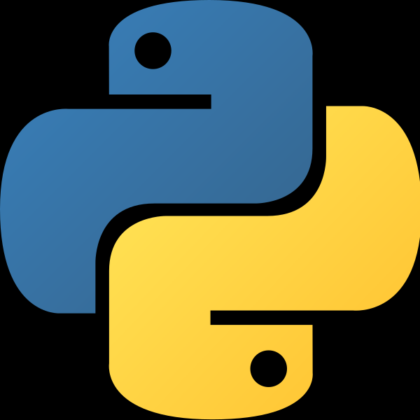

Python Course
(Basics)

Slide 3
To build a MP3 Player in Python!

Slide 4
Agenda for Today
Introduction
What can you do?
What are we going to do?
Some Prerequisites
Algorithm
Flowchart

Slide 5
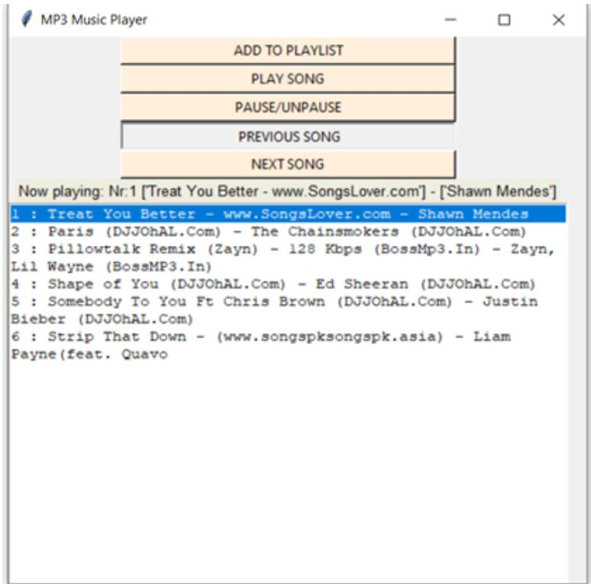
Introduction

Slide 6
Introduction
We need an application that will allow us to play or listen to digital audio files. MP3 player is the device to play MP3s and other digital audio files. The MP3 GUI program application attempts to emulate the physical MP3 Player. This program will allow you to play songs, music, and all MP3 files on your desktop or laptops.
This GUI project is developed using Python programming language. The GUI aspect of the application is built using the Tkinter library of Python. The interactive part of the application that handles the MP3 files uses the Pygame and Mutagen libraries.

Slide 7
What can you do?
You can have an interface for listing the available MP3 files.
You can also give users the option to list other digital audio files that are not MP3.
The users will also expect the MP3 Player to have an interface that shows information on the file that is playing.
Some of the information you can include are the name of the file, its length, the amount played, and the amount not played, in minutes and seconds.
You can also implement a feature that allows users to create a playlist. To do this, you’ll need a database to store information on the created playlists.
This GUI project is developed using Python programming language. The GUI aspect of the application is built using the Tkinter library of Python. The interactive part of the application that handles the MP3 files uses the Pygame and Mutagen libraries.

Slide 8
Some Prerequisites
To build this project we will use the basic concept of python and libraries –
Tkinter is a standard GUI library and is one of the easiest ways to build a GUI application.
Python has libraries that can play audio files, such as Pygame, which allows you to work with multimedia files in few lines of code. Similar libraries are Pymedia and Simpleaudio.
Python’s sqlite3 module allows you to use the SQLite database. While SQLite is file based, it is better for saving data than a regular file.

Slide 9
What are we going to do?
Let’s check the steps to build a MP3 Player using Python-
To build an MP3 player using Python programming language to be able to play and listen to songs, MP3 files and other digital audio files.
Determine the functionalities of the MP3 player.
The player should be have a simple and easy to use GUI with options for various functions, display screen to display the entire playlist and buttons to shut down the player.
The player should be able to play any song. It should be capable of playing MP3 files or any other digital audio files.

Slide 10
What are we going to do?
Let’s check the steps to build a MP3 Player using Python-
5.The player should allow the user to browse through the contents of the computer drive to choose song/s to be played or queued.
6.It should provide the user with option to pause or resume the song.
7.The user should be able to play the previous or the next song in the playlist.
8.Lastly, the user should get basic details about the current playing song. The details can include the song name, singer’s name, the duration of the song, size of the file, etc.

Slide 11
ALGORITHM
1.Import the libraries. 2. Create an object of the tkinter and Pygame libraries. 3. Create a window using Tkinter object. 4. Add buttons that provide different functionalities. Add a song Play the song Pause the song Play previous song Play next song 5. Add a song button when pressed should open a dialog box to browse and choose the file. 6. Add label to display the song’s information. • Name • Singer • Duration • Size of the file, etc. 7. Display screen will display the details of the entire playlist. 8. Close button will automatically clear the song list and will stop playing the song

Slide 12
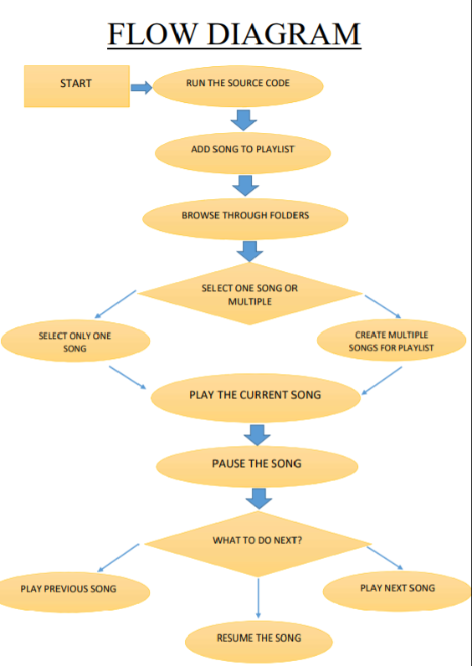

Slide 13
Thank You!

